Slide 1
Welcome to MIDL!
¡Bienvenido! Bienvenue! Herzlich Wilkommen!

Slide 2

Molecular Infectious Disease Laboratory
What is the Molecular Infectious Laboratory?
MIDL is one of the two clinical laboratories that offers molecular-based platforms for diagnostic testing.
Diagnostic testing versus research laboratories
MIDL’s test directory and different PCR assay platforms
Importance of tests (or assays) to VUMC’s physicians

Slide 3

Tests Offered in the Molecular Infectious Disease Lab
EHD
VZD
HSD
CMD
CMQ
HNA
HVG
HCQ
HC5
EBD
EBQ
BKV
PVB
CGD
GCD
CTD
TRICH
HPP
HBD
GIP
MEP
RPP
EVD
http://memecrunch.com/meme/UGLB/what-does-that-even-mean/image.jpg?w=400&amp;c=1

Slide 4
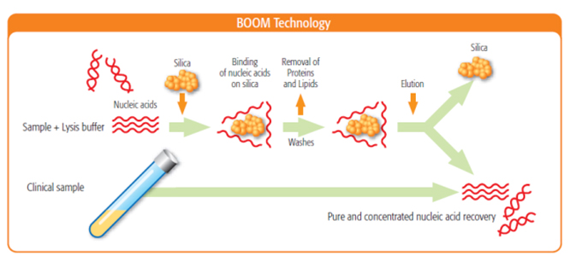
Basic Breakdown on Molecular Technology
MIDL incorporates many molecular platforms, but the first concept to understand is the breakdown on how we start the testing process from start to finish
The first step is to extract DNA or RNA, depending on what organism is targeted, and the platform used to extract purified DNA or RNA.
MIDL uses the EasyMAG system to lyse, bind DNA/RNA with magnetic silica (silica DNA/RNA), wash impurities from the silica-DNA/RNA hybrid, and finally elute the purified DNA or RNA from the silica.
https://www.biomerieux-diagnostics.com/sites/clinic/files/boom-technology.jpg

Slide 5
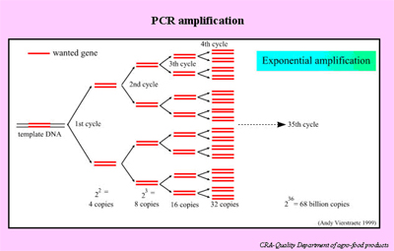
Basic Breakdown on Molecular Technology
The second step is to amplify the requested target(s). This step uses mastermix, which contains primers, probes, and enzymes needed for the PCR process. The mastermix is added to the purified DNA or RNA extract., usually in a cuvette or 96-well plate, for amplification
http://stratfeed.cra.wallonie.be/img/page/PCR_web_page5.jpg

Slide 6
Basic Breakdown on Molecular Technology
The third step in molecular testing is the detection of a target or signal.
Many assays offer different detection steps, depending on the platform’s
manufacturer, which includes:
Electrochemical
Chemiluminescence
Hybrid capture or ELISA
XMAP (or bead technology)

Slide 7
Real-Time PCR
Tests that use RT-PCR technology:
CMV, EBV, HBV, HCV, HIV-1, BKV These are tests where a viral load is measured.
CMV, EBV, and BKV are lab orders generated by treating physicians to monitor viral loads in
immunocompromised and/or transplant recipients. The morbidity and mortality of these viruses to this
subset of patients are well known.
HIV-1, HCV, and HBD genomic copy levels are monitored by doctors who have prescribed these patients
specific medications to help bring these viruses to undetectable loads. If a viral load changes drastically, then a
physician will order a genotype to determine if the genetic structure of the virus mutated.
HPV and CT/NG are sexually transmitted viruses that are measured by this testing platform.

Slide 8
Importance of Genotyping HCV and HIV
Goals of these drug are to:
Control the growth of the virus
Improve how well the immune system works
Slow or stop symptoms
Prevent transmission of HIV to others.
MIDL extracts, amplifies, sequences, and then analyzes the patient’s consensus sequence
for accuracy against a reference sequence. The software has a built-in algorithm that
determines if the patient is susceptible or resistant to different ART drugs currently
available.
HIV-1 is an RNA virus that mutates. When a physician requests a genotype, he or she is trying to monitor current medication efficacy.
Current types of Antiretroviral therapy (ART):
Nucleoside/Nucleotide Reverse Transciptase inhibitors
Non-nucleoside Reverse Transcriptase Inhibitors
Protease Inhibitors

Slide 9
Importance of Hepatitis C Genotyping
Hepatitis C has different genotypes, which are Types 1a, 1b, 2b,
2a, 2c, 3, 4, 5, 6
New drugs developed as a cure for Hep. C
What does this mean?
People on transplant waiting lists can receive organs that are
Hepatitis C positive and then receive the drug Harvoni.

Slide 10
Biofire
This is a new testing platform that has a simple specimen set-up and rapid turn-around-time for multiple targets…infectious organisms. The FILMARRAY is an FDA-cleared multiplex PCR system that integrates sample preparation, amplification, detection and analysis.
Respiratory Pathogen Panel:
One specimen (300 uL) is all that is needed to use this technology, which can detect viruses and bacteria that are known culprits for lower and upper respiratory infection.
Meningitis and Encephalitis Panel:
Only 200 uL of cerebrospinal fluid (CSF) is needed to detect multiple targets responsible for meningitis and encephalitis.
Gastrointestinal Pathogen Panel:
A small amount of stool specimen can detect multiple viruses, parasites, and bacteria in as little as one hour.

Slide 11
Importance of the Molecular Infectious Disease Lab
Laboratory testing is a key part of the medical field. The Medical Laboratory Scientist provides data to the physician, which aids in the
diagnosis and treatment for a patient
The laboratorian maintains lab-wide safety standards because if such work is not done properly, it could mean life or death for a
patient. In MIDL, contamination is a risk that could have serious implications.
When health risks are diagnosed early, they usually cost less to treat. Medical testing plays an important role in managing these
financial factors.
As fully trained, educated medical professionals, we understand the mechanisms and purpose of the many tests that physicians order.

